Slide 1


YYYY-MM-DD HH:MM:SS
Notes:
Database store dates in year month days then time in hour min sec

Slide 2

DATE_FORMAT
2024-04-01 3 :30:03
2024-04-01 5 :12:26
2024-04-01 12:05:37
2024-04-01 22:45:10
2024-04-01 00:00:00
Notes:
To group events by day, adjust all the times on April 1st 2024 using the date format function

Slide 3
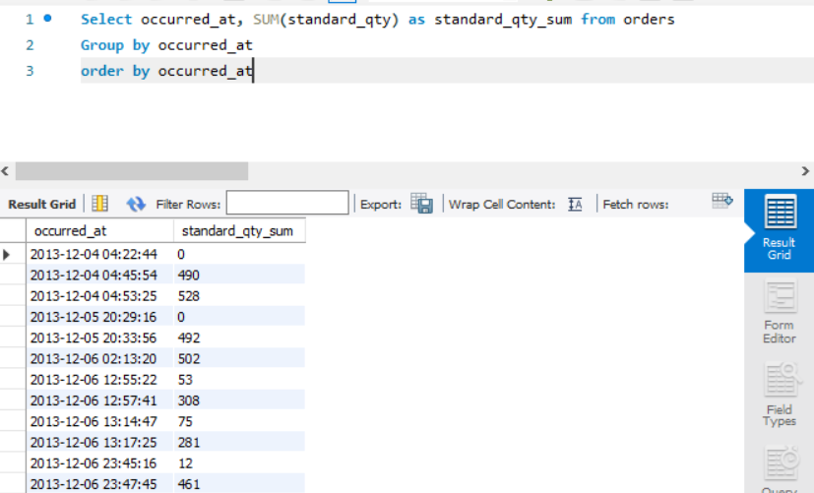
DATE_FORMAT(COL_name, ‘FORMAT')
Notes:
replace each instance formated version and get your event result as here the sum of sales by day

Slide 4
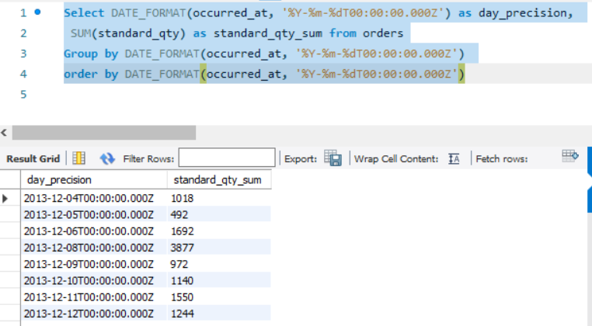
Notes:
It's important to group by the same metric that's included in the select statement to assure your results

Slide 5
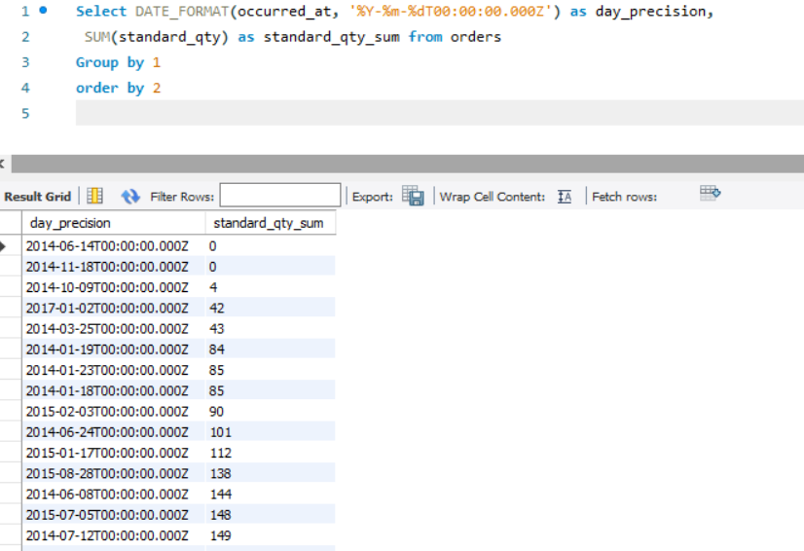
1 : for Date Column
2 : for Sum Column
Notes:
The easiest way to make sure you group correctly is to use column numbers instead of retyping the exact functions.

Slide 6
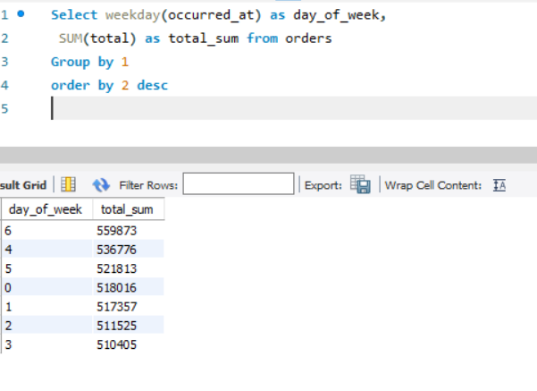
0 : for Monday
6 : for Sunday
Notes:
By using WEEKDAY() function that returns a value from zero to six, we know in which day the most sales occures

